Slide 1
Geothermal Energy
By Marvin Baeumer

Slide 2
Table of contents
1
2
3
Concept
Types
Usages
4
5
6
Pros
Cons
Resources

Slide 3
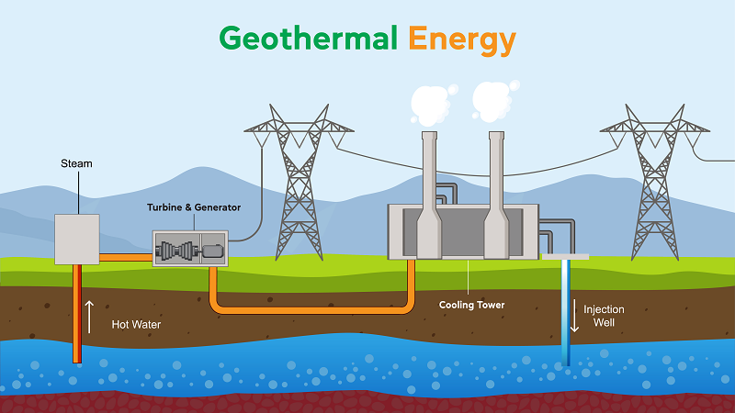
1
2
3
Hot water
Steam
Turbine
5
4
Injection
Cooling
Concept
Notes:
Geothermal power stations work by pumping hot water from deep underground and using the resulting vapour to drive a turbine which then produces electricity. After the turbine has been driven, the water is cooled and pumped back in. This can then be reheated and pumped up again, creating a cycle. Let's have a closer look.

Slide 4
Concept

Slide 5
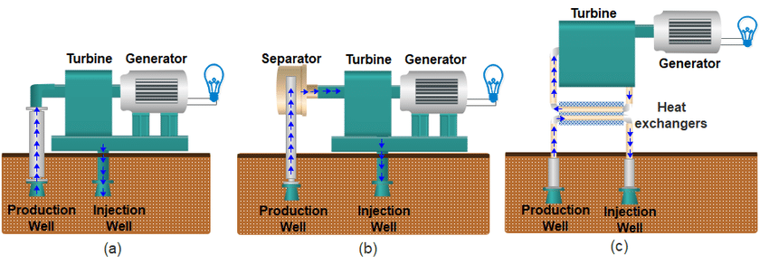
Planet – Earth
Crust
35 – 410 km
Core
3 Kelvin = 100m
Notes:
The temperature rises by 3 Kelvin every 100 meters. A geothermal power plant requires boreholes from 1600 meters to 5000 meters deep. Let's have a closer look at the different types of Geothermal power plants

Slide 6
Different types
Flash plants
Dry steam
Binary plants
Notes:
There are three types. The oldest power plant is the dry steam power plant. It uses steam directly from the ground to drive a turbine. The most common is the flash plant, which uses steam from hot water. The most modern power plants are the binary plants, where hot water is mixed with another liquid. The other liquid has a higher boiling point and therefore evaporates. This vapour is then used

Slide 7
Uses of geothermal energy
Heating
Electricity
Cooling
Notes:
- **Electricity Generation:** Geothermal power plants convert the Earth's heat into electricity. Steam or hot water from the geothermal reservoir is used to turn turbines
- **Geothermal Heat Pumps (Heating):** Geothermal heat pumps use the Earth's stable temperature to heat buildings during cold periods. They extract heat from the ground and transfer it indoors.
- **Geothermal Heat Pumps (Cooling):** In warmer weather, geothermal heat pumps can reverse their operation, extracting heat from buildings and transferring it into the cooler ground, providing efficient cooling.

Slide 8
Advantages of geothermal energy
Constantly available
Cheaper
Enviroment friendly

Slide 9
Disadvantages of geothermal energy
Location
Sulphide
Drilling

Slide 10
Resources
https://www.twi-global.com/technical-knowledge/faqs/geothermal-energy (17.01.2024)
https://www.wtsenergy.com/glossary/geothermal-energy/ (16.01.2024)

